Slide 1


1. Abstract
In this project, we conducted a comprehensive analysis of Amazon product listings to understand pricing strategies, customer satisfaction, and market segmentation. We investigated the relationship between product ratings, categories, and prices using various statistical and machine-learning models. Our methodology involved data collection through Kaggle, exploratory data analysis with statistical summaries, visualizations, and hypothesis testing, followed by the construction of regression and clustering models. Our findings reveal intricate patterns in consumer behavior and provide insights for optimizing online retail strategies.

Slide 2

2. Introduction
The online retail market is a compendium of consumer preferences, pricing strategies, and competitive positioning. Our study focuses on Amazon, a leading e-commerce platform, to discern patterns in product pricing and customer ratings. By examining a substantial dataset of product listings, we aim to answer how prices correlate with customer satisfaction and how products can be effectively segmented by their features and consumer perception. This report elucidates our research methodology, the significance of our project in understanding e-commerce dynamics, and the structure of our analysis, which encompasses data collection, exploratory analysis, modeling, and interpretation of results.
"product_id" "product_name" "category" "discounted_price" "actual_price" "discount_percentage" "rating"
"rating_count" "about_product" "user_id" "user_name" "review_id" "review_title" "review_content"
"img_link" "product_link" "discounted_price_log" "category_split" "category_main"
KARKAVELRAJA J. (Updated a Year Ago). Amazon Sales Dataset, Version 1.0. Retrieved [Date Retrieved] from https://www.kaggle.com/datasets/karkavelrajaj/amazon-sales-dataset.

Slide 3
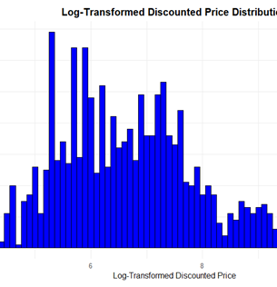
Price Distribution: A histogram of log-transformed prices indicated a skewed distribution, common in retail settings.
"This histogram displays the distribution of log-transformed discounted prices for a range of products. Log transformation is applied to normalize the data and reveal the underlying trends more clearly. The chart shows multiple peaks, indicating that products cluster around certain price points. The majority of products have their prices in the mid-range, as shown by the taller bars, with fewer products at the higher price end. This suggests a diverse assortment of product pricing within the dataset."

Slide 4
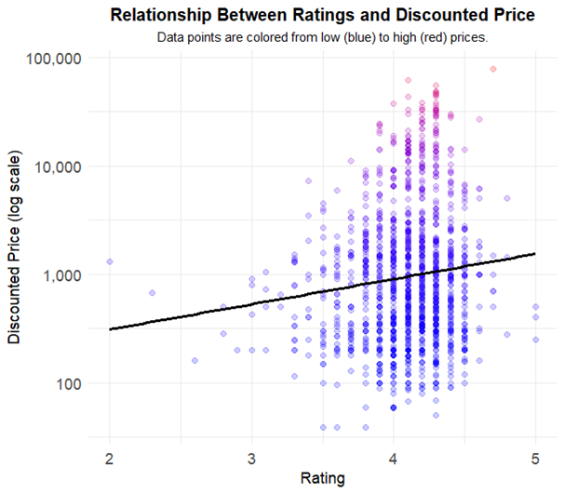
Relationship between product ratings and their discounted prices on Amazon
"Let's turn our attention to this scatter plot, which reveals the relationship between product ratings and discounted prices on Amazon. Notice the range of colors from blue to red, showing low to high prices respectively. The plot highlights that higher-rated products do not necessarily come with higher prices – a crucial insight for consumers seeking value. The trend line suggests only a weak correlation between price and quality, as defined by ratings. This information empowers us as buyers to make informed decisions, understanding that a higher price tag doesn't always correlate with better product quality."

Slide 5
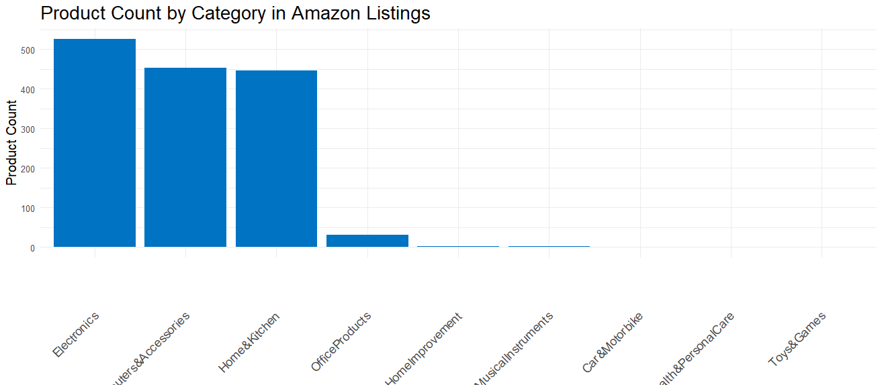
Category Analysis: A bar chart showcased the distribution of products across different categories.
The chart is a bar graph showing the number of products listed on Amazon within different categories. It ranks the categories by the number of products they contain, from highest to lowest. The 'Electronics', 'Computers & Accessories', and 'Home & Kitchen' categories have the most products.

Slide 6
Linear Regression: To understand the relationship between product ratings, categories, and prices.
Residuals:
Min 1Q Median 3Q Max
-7397 -3034 -786 463 69762
Coefficients:
Estimate Std. Error t value Pr(>|t|)
(Intercept) -11564.7 6902.5 -1.675 0.0941 .
rating 3658.9 595.9 6.140 1.06e-09 ***
category_mainComputers&Accessories -2795.1 6531.1 -0.428 0.6687
category_mainElectronics 2596.0 6528.8 0.398 0.6910
category_mainHealth&PersonalCare -2171.8 9222.1 -0.235 0.8139
category_mainHome&Kitchen -888.6 6529.3 -0.136 0.8918
category_mainHomeImprovement -3648.5 7990.4 -0.457 0.6480
category_mainMusicalInstruments -2066.9 7986.1 -0.259 0.7958
category_mainOfficeProducts -3902.3 6631.8 -0.588 0.5563
category_mainToys&Games -4018.4 9226.1 -0.436 0.6632
---
Signif. codes: 0 ‘***’ 0.001 ‘**’ 0.01 ‘*’ 0.05 ‘.’ 0.1 ‘ ’ 1
Residual standard error: 6520 on 1454 degrees of freedom
(1 observation deleted due to missingness)
Multiple R-squared: 0.1244, Adjusted R-squared: 0.1189
F-statistic: 22.94 on 9 and 1454 DF, p-value: < 2.2e-16

Slide 7

Word Cloud
This word cloud is a visual representation of the most frequently occurring words within the product descriptions on Amazon. The size of each word in the cloud is proportional to its frequency of occurrence: the larger the word, the more often it appears in the dataset.
Prominent words like 'cable', 'USB', 'charging', 'design', and 'warranty' suggest that these are key features customers are interested in. This could be indicative of a focus on product specifications and quality assurances in the descriptions, which are important factors for consumer decisions. The presence of terms like 'fast', 'compatible', and 'durable' highlights the emphasis on product functionality and reliability.

Slide 8
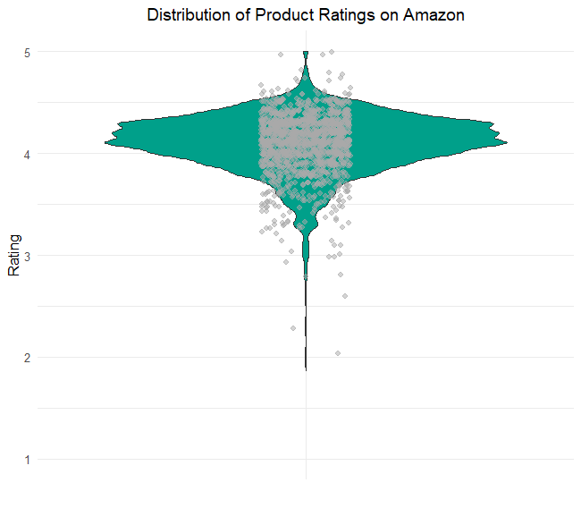
Rating Distribution: A violin plot of product ratings highlighted a concentration of higher ratings.
This chart is a violin plot combined with a scatter plot (often called a "beeswarm plot") that illustrates the distribution of product ratings on Amazon. The violin plot aspect of the chart shows the density of the ratings at different levels, with the widest sections of the 'violin' indicating the most common ratings. The plot indicates a high density around the 4 to 5 rating range, which suggests that a majority of products receive high ratings.

Slide 9
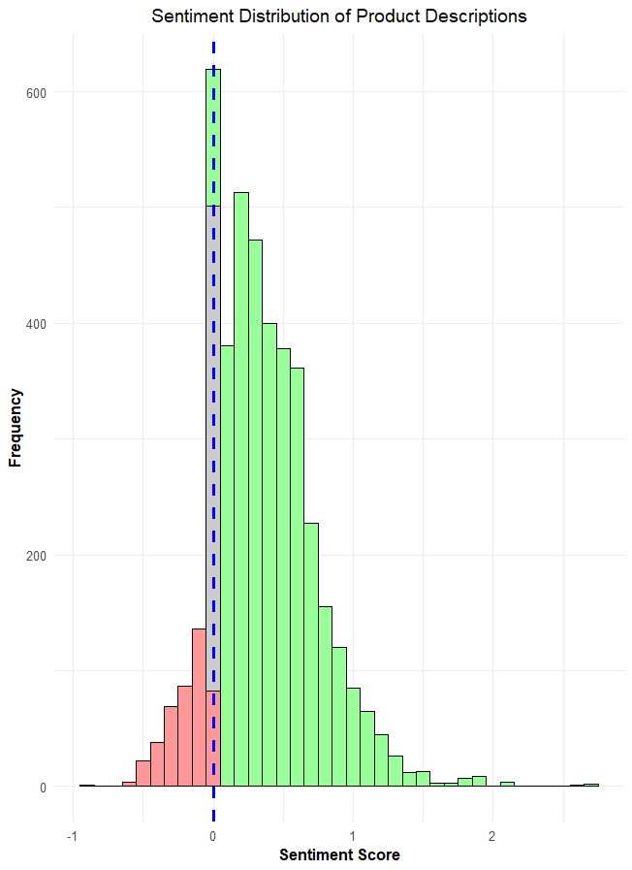
Title: Sentiment Analysis of Amazon Product Descriptions
Content: This histogram represents the sentiment distribution of Amazon product descriptions. The x-axis shows the sentiment scores, ranging from negative to positive, while the y-axis displays the frequency of each score. Negative sentiments are colored in light red, positive in light green, and neutral scores are in grey. The dashed blue line marks the neutral sentiment score of zero.
Key Takeaways:
A majority of the product descriptions have positive sentiment scores.
Negative sentiments are far less frequent, suggesting generally favorable descriptions.
The peak near zero may indicate a prevalence of neutral language.

Slide 10
Clustering Analysis: Employed K-means
> # K-means Clustering
> set.seed(123)
> kmeans_result <- kmeans(clustering_data, centers = 3)
> print(kmeans_result$centers)
rating discounted_price
1 -1.6936277 -0.2688002
2 0.3385368 2.9836658
3 0.3152794 -0.2283831
> print(kmeans_result$size )
FIRST -231
SECOND -107
THIRD -1126
K-means clustering used to segment data into 3 groups.
Cluster centers represent the average rating and discounted price for each group.
Size of each cluster indicates the number of data points it contains.

Slide 11

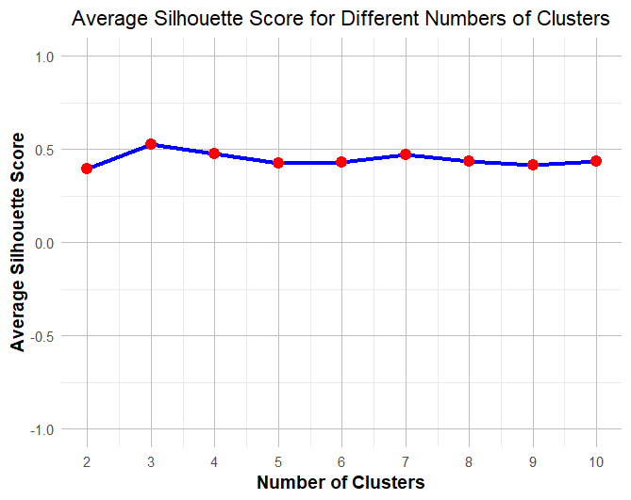
Title: Optimal Cluster Count Determination via Silhouette Analysis
Content:
The line chart displays average silhouette scores for k-means clustering when varying the number of clusters from 2 to 10.
A higher silhouette score indicates better-defined clusters.
The optimal number of clusters, as suggested by the highest silhouette score, appears to be 3.
This analysis assists in validating the cohesiveness of clustering in our dataset.
Notes:
This chart illustrates the silhouette scores for different numbers of clusters in our k-means clustering analysis.
This chart shows silhouette scores for k-means clustering with different cluster counts. The silhouette score assesses how well an item fits in its cluster. We see the best score with three clusters, indicating a clear distinction between them, which confirms our clustering approach

Slide 12
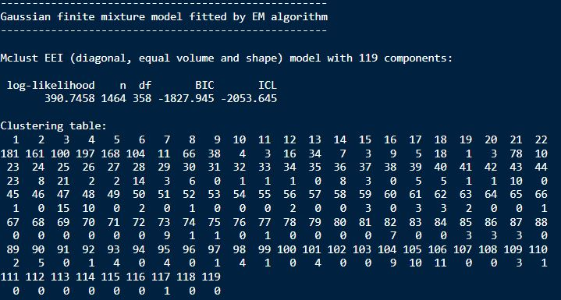
Gaussian finite mixture model fitted by EM algorithm
Applied a complex clustering technique using the Gaussian Mixture Model.
Model identified 119 different groups within the data.
Optimization done through the EM algorithm to ensure precise grouping.
Log-likelihood and other statistics indicate the model's fit to the data.

Slide 13
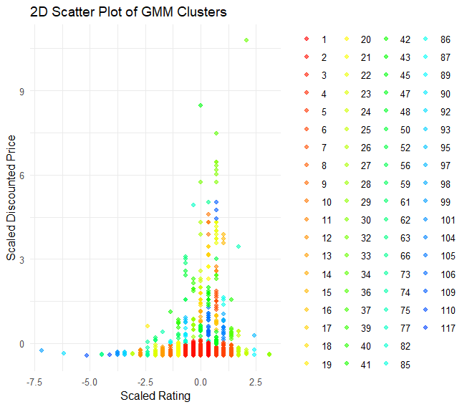
"2D Scatter Plot of GMM Clusters"
Visualization of data clustered by Gaussian Mixture Model (GMM).
X-Axis: Scaled Rating
Y-Axis: Scaled Discounted Price
Each color represents a distinct cluster.
Purpose: To identify patterns and groupings not immediately apparent in raw data.
The chart you’re looking at maps out how we’ve grouped data using a tool called the Gaussian Mixture Model. Picture each dot as an item for sale, where its placement is determined by its rating and price after we've adjusted them to compare more easily. The colors separate the items into different groups. This helps us spot trends and patterns that we wouldn't see just by looking at the raw numbers.

Slide 14

6. Summary of Learning
The project was a deep dive into the data-driven understanding of e-commerce, presenting both challenges and learning opportunities. Interpreting complex patterns in consumer ratings and pricing strategies required a robust analytical approach. Interesting findings emerged around the nuanced relationship between product prices and customer satisfaction. The project honed our skills in data analysis and model evaluation, emphasizing the importance of iterative learning and application of statistical concepts in real-world scenarios.
Through this project, I've encountered challenges in data analysis, particularly in handling large datasets and ensuring accurate clustering. The exploration of Amazon's pricing strategy revealed intriguing patterns, emphasizing the importance of customer ratings on pricing. I learned new analytical techniques, such as Gaussian Mixture Models, and honed my self-learning skills, especially in statistical methods and machine learning. The project was a practical lesson in data science, teaching me to derive actionable insights from complex information.

